Slide 1
Moles and Molar Mass

Slide 2

Welcome to this Smart Lesson about moles and molar mass. After you have completed this lesson you should be able to:
Define a mole and state how many particles it represents.
Calculate the molar mass of elements and compounds.
Manipulate the relationship between mass, molar mass and amount in moles of elements or compounds.

Slide 3
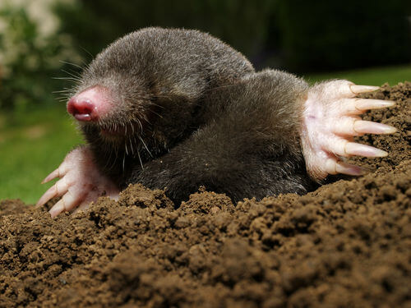
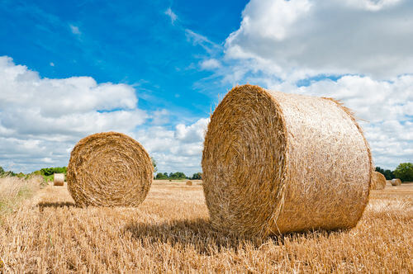
To fully understand a chemical reaction we often need to know exactly how many particles are present in each of the elements, ions or molecules that are reacting.
However, these particles are so small and there are some many of them that it would be very difficult to count the atoms, ions or even molecules individually. It would be like trying to count the number of individual blades of grass that make up a hay bale!
In this lesson we are going to learn about a convenient way of counting particles called the mole. When counting hay we usually state the amount of hay in bales and in a similar way when counting particles we usually state the amount of particles in moles.

Slide 4
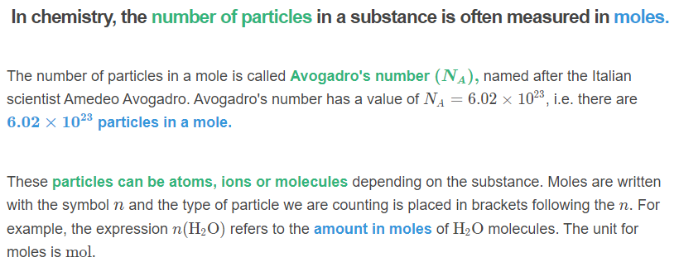
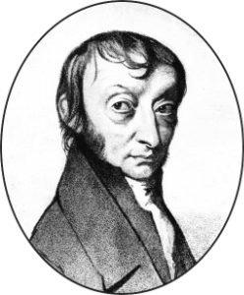

Slide 5
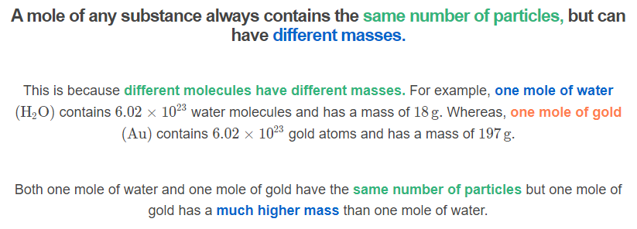


Slide 6
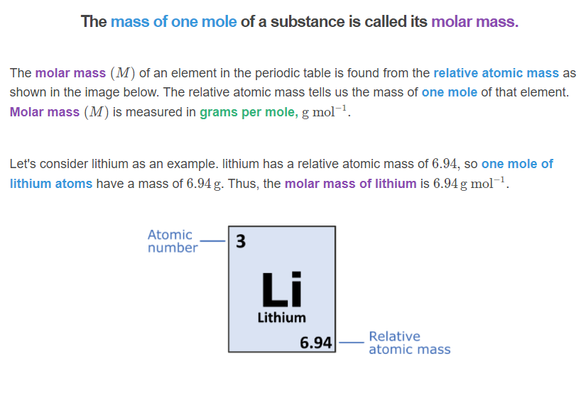

Slide 7
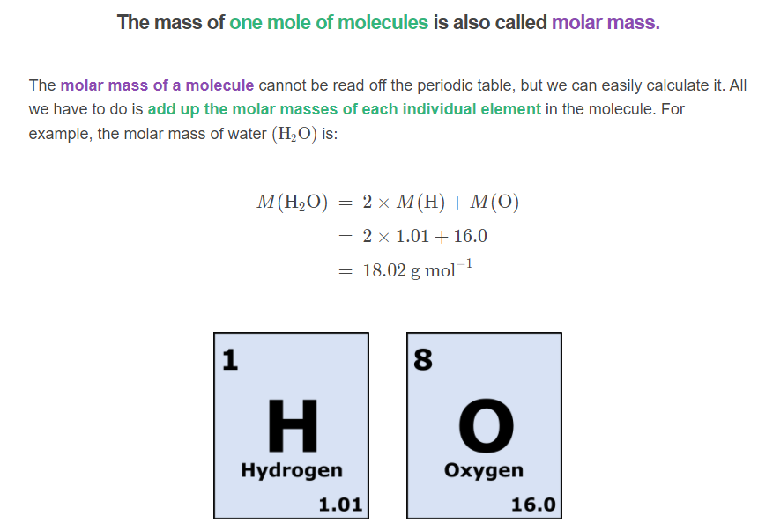

Slide 8
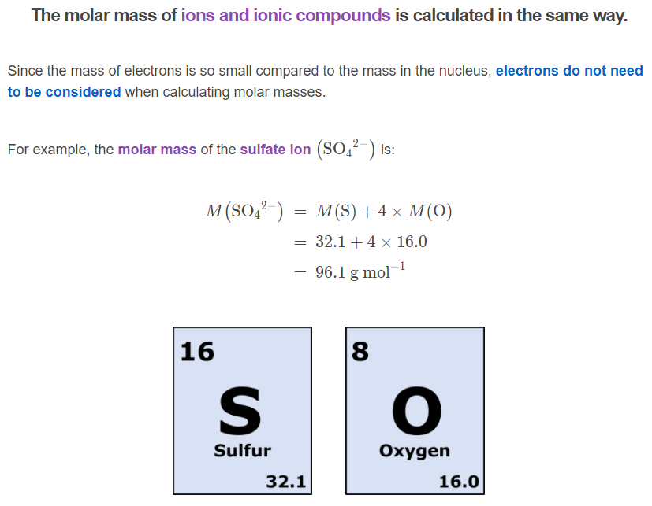

Slide 9
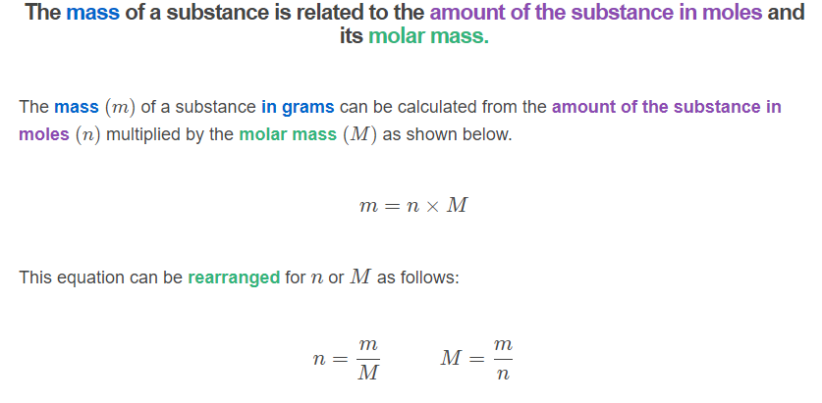

Slide 10
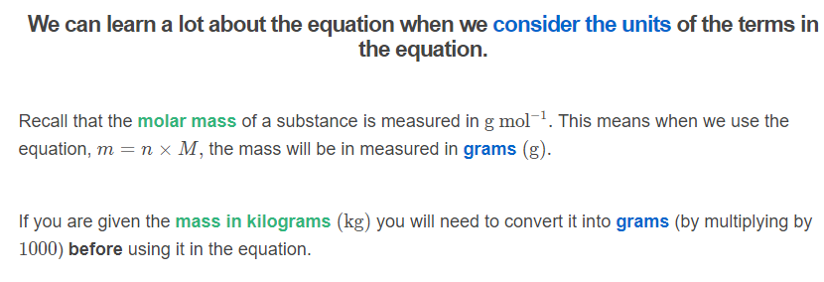
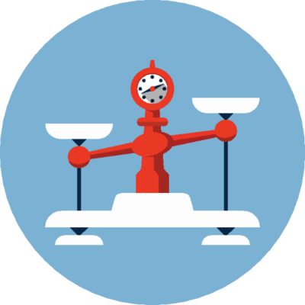

Slide 11
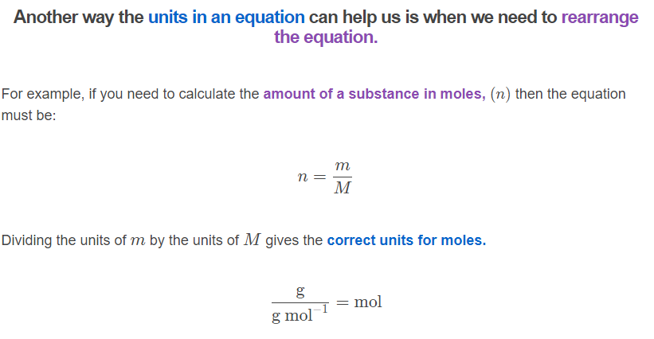

Slide 12
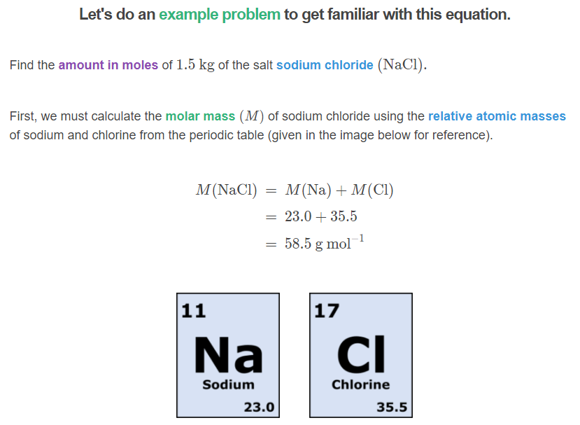

Slide 13
